Slide 1

Occam’s Razor
Explained for Beginners
What do we mean by “simple”? What do we mean by “better”?

Slide 2
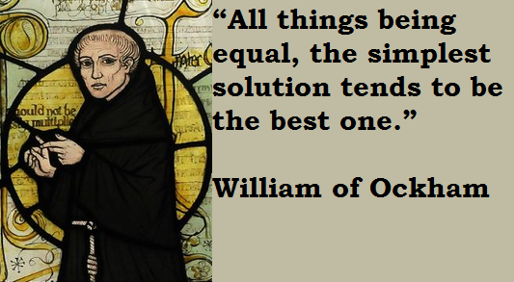
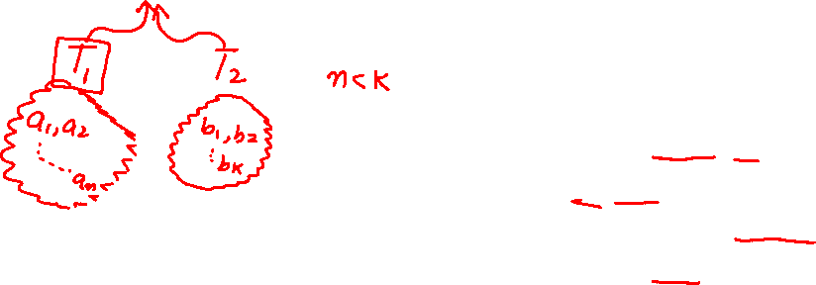
Occam’s Razor
Medium.com

Slide 3
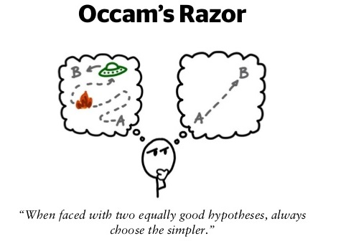
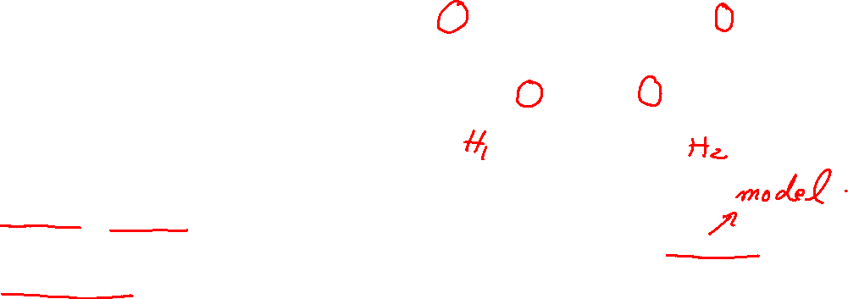
Simpler is Better
https://automaticaddison.com/

Slide 4
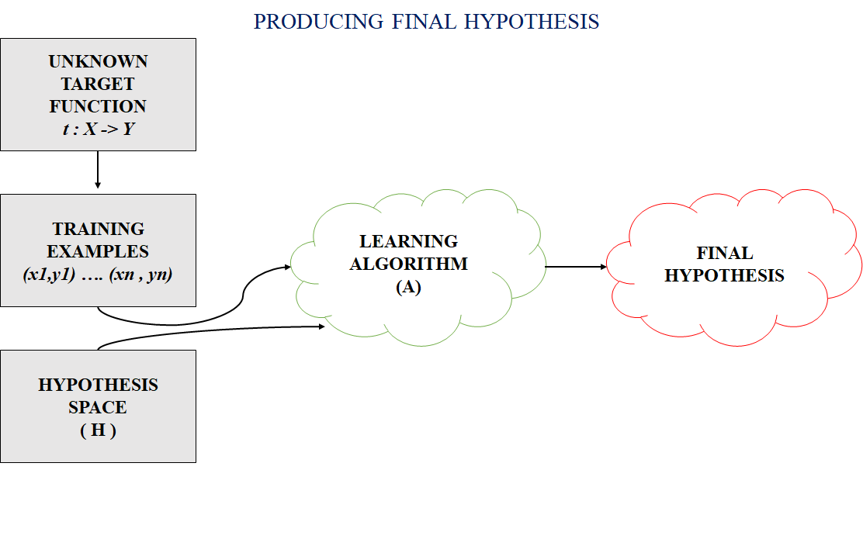
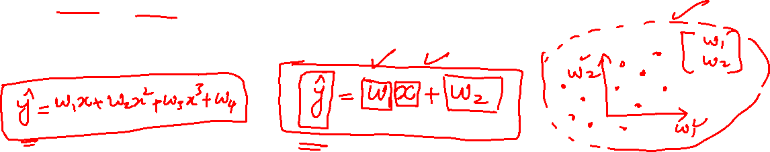
Simple?
geeksforgeeks.org

Slide 5
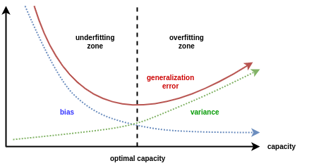
Better?
Medium.com

Slide 6
Website : www.aisciences.io

